Slide 1

M S D S 6 1 0 | F A L L 2 0 2 3 | F I N A L P P T
Hypothesis Testing
S A N G J U N | S H R E Y | B E L I N D A
Notes:
Hypothesis testing is a fundamental concept in statistics that plays a crucial role in scientific research, decision-making, and problem-solving. For example, businesses and organizations use hypothesis testing to manage risks. By testing hypotheses about market trends, customer preferences, or the impact of a decision, organizations can make more informed choices and reduce the risk of making costly mistakes. In simple terms, hypothesis testing helps us avoid making big mistakes by relying our choices on solid evidence.
We are going to set up our statement and see if it has enough evidence to support or not. We will explain step by step how to go over hypothesis testing by using python. Let’s jump into more details.

Slide 2



Welcome everyone!
Sangjun Han
Shrey Jain
Belinda Ong

Slide 3


Agenda
Setting the scene: Data and Python packages used
Comparing the means of two populations
Visual representation
The impact of outliers
Type 1 v 2 error
Recent controversies

Slide 4
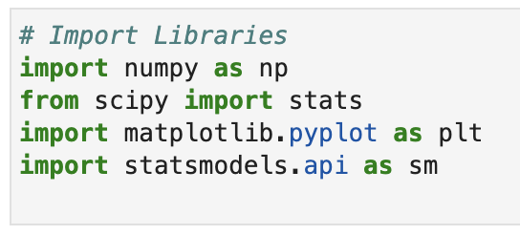
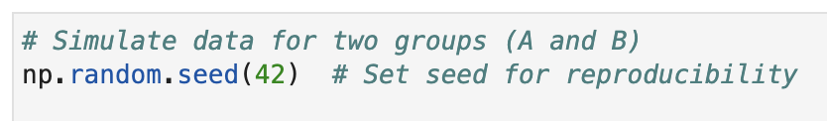
The Python packages we are using are numpy, scipy, matplotlib, and statsmodel
Setting the stage for today’s presentation
The data we are using is simulated using numpy with random seed 42

Slide 5
Agenda
Setting the scene: Data and Python packages used
Comparing the means of two populations
Visual representation
The impact of outliers
Type 1 v 2 error
Recent controversies

Slide 6
H₀: μ_{A} = μ_{B}
H_{a}: μ_{A} ≠ μ_{B}
The null and alternative hypothesis we will be testing

Slide 7
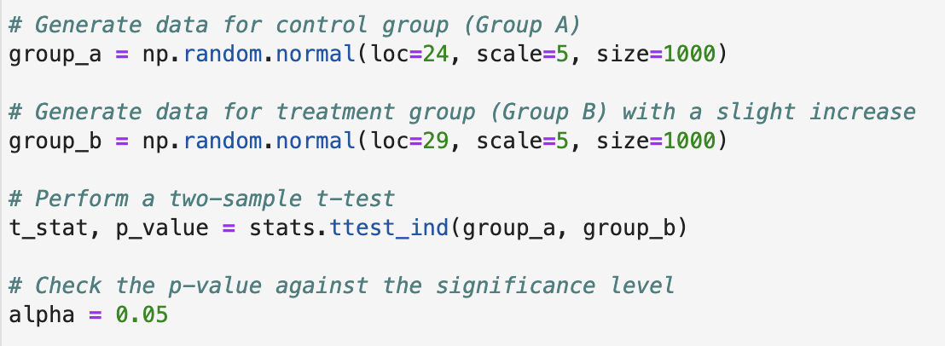
P-value is 0.000 < alpha = 0.05
Reject the null hypothesis
There is a significant difference between the groups.
Conducting the t-test with Python

Slide 8
Agenda
Setting the scene: Data and Python packages used
Comparing the means of two populations
Visual representation
The impact of outliers
Type 1 v 2 error
Recent controversies

Slide 9
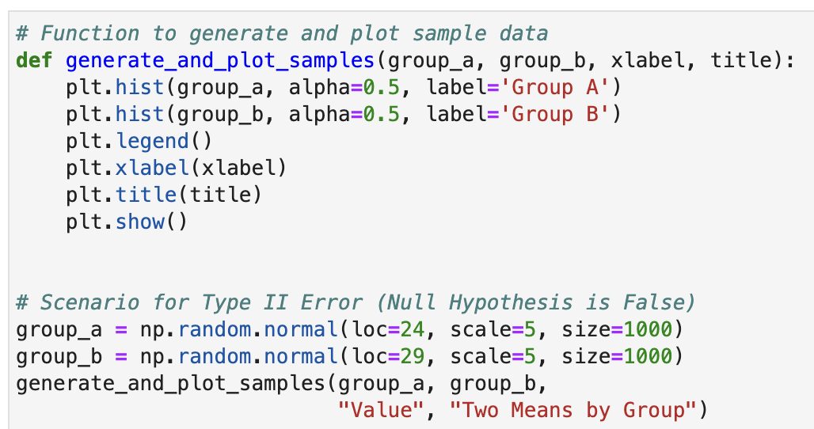
Visualizing the test - code used

Slide 10
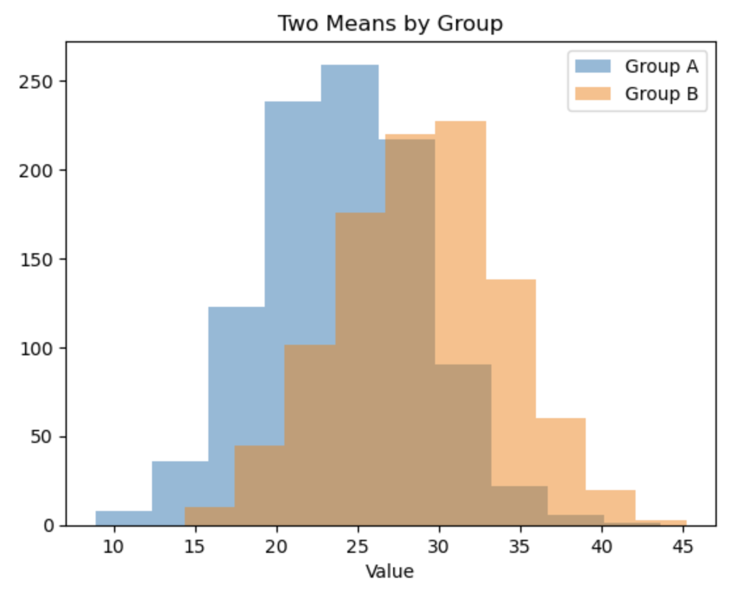
Visualizing the test - chart representation

Slide 11
Agenda
Setting the scene: Data and Python packages used
Comparing the means of two populations
Visual representation
The impact of outliers
Type 1 v 2 error
Recent controversies

Slide 12
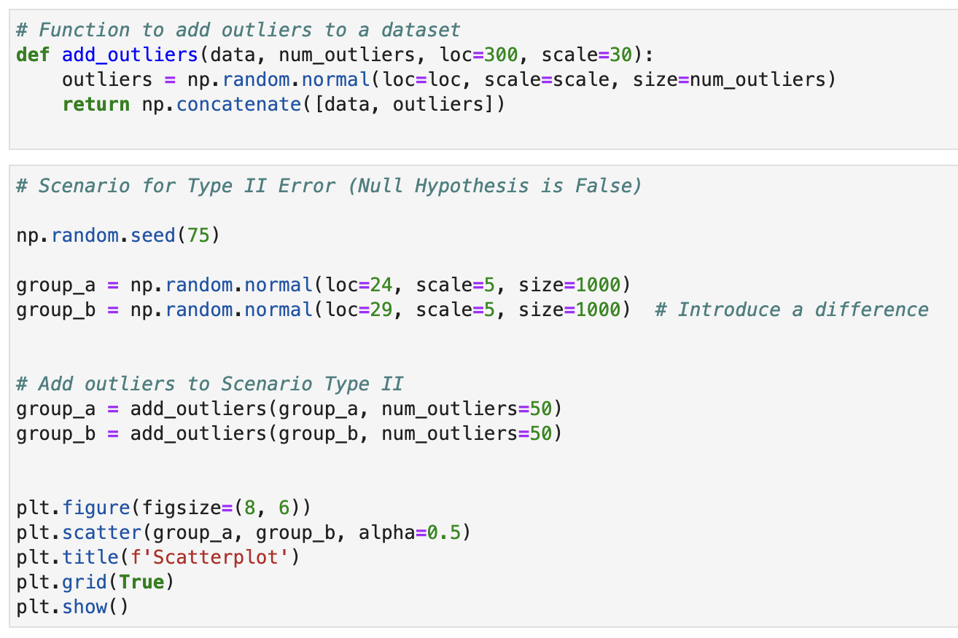
What if there are outliers in the dataset? - code used

Slide 13
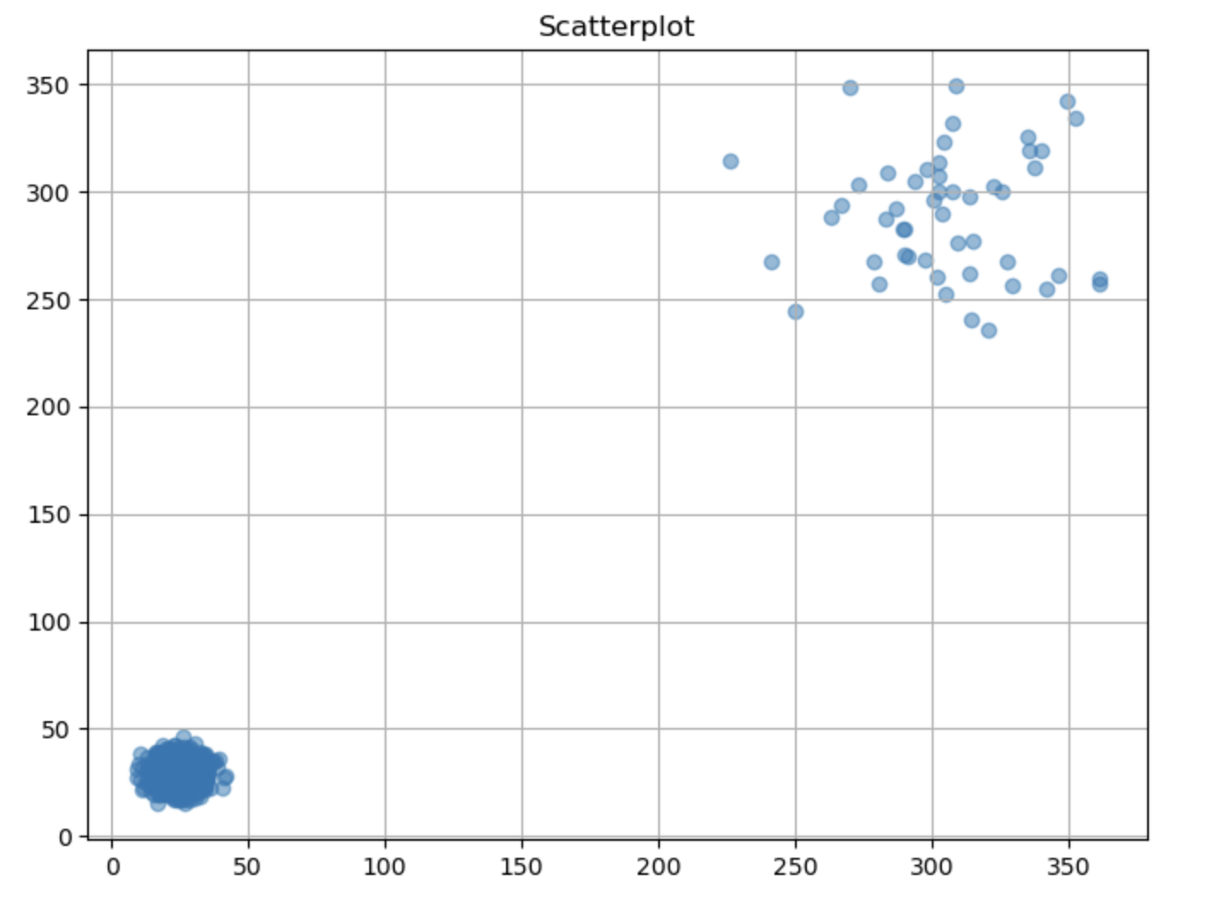
What if there are outliers in the dataset? - chart representation

Slide 14
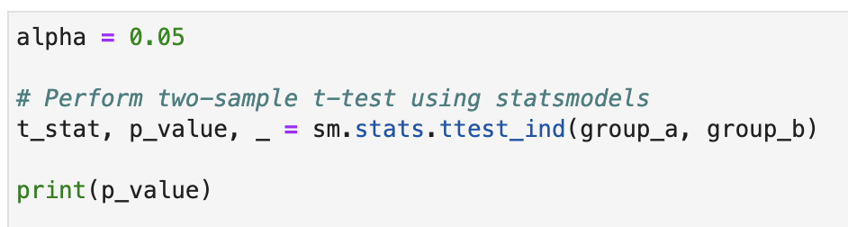
P-value: 0.121 (3 d.p.) > alpha = 0.05
Fail to reject the null hypothesis.
Type II Error: Failed to detect a significant difference.
What if there are outliers in the dataset? - running the test

Slide 15
Agenda
Setting the scene: Data and Python packages used
Comparing the means of two populations
Visual representation
The impact of outliers
Type 1 v 2 error
Recent controversies

Slide 16
Type I error: Rejecting the null hypothesis when it is true (false positive)
Type II error: Failing to reject the null hypothesis when it is false (false negative)
Type I v II errors

Slide 17
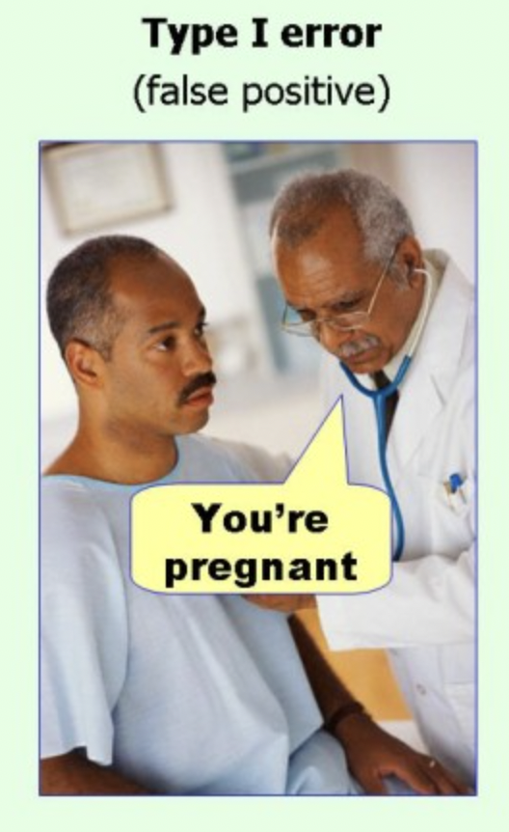
Type I error

Slide 18
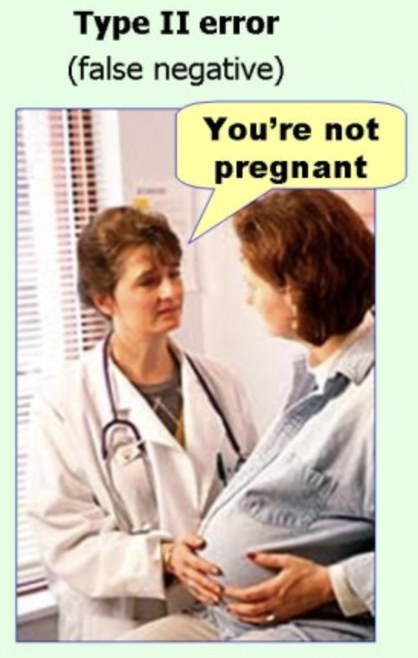
Type II error

Slide 19
Agenda
Setting the scene: Data and Python packages used
Comparing the means of two populations
Visual representation
The impact of outliers
Type 1 v 2 error
Recent controversies

Slide 20
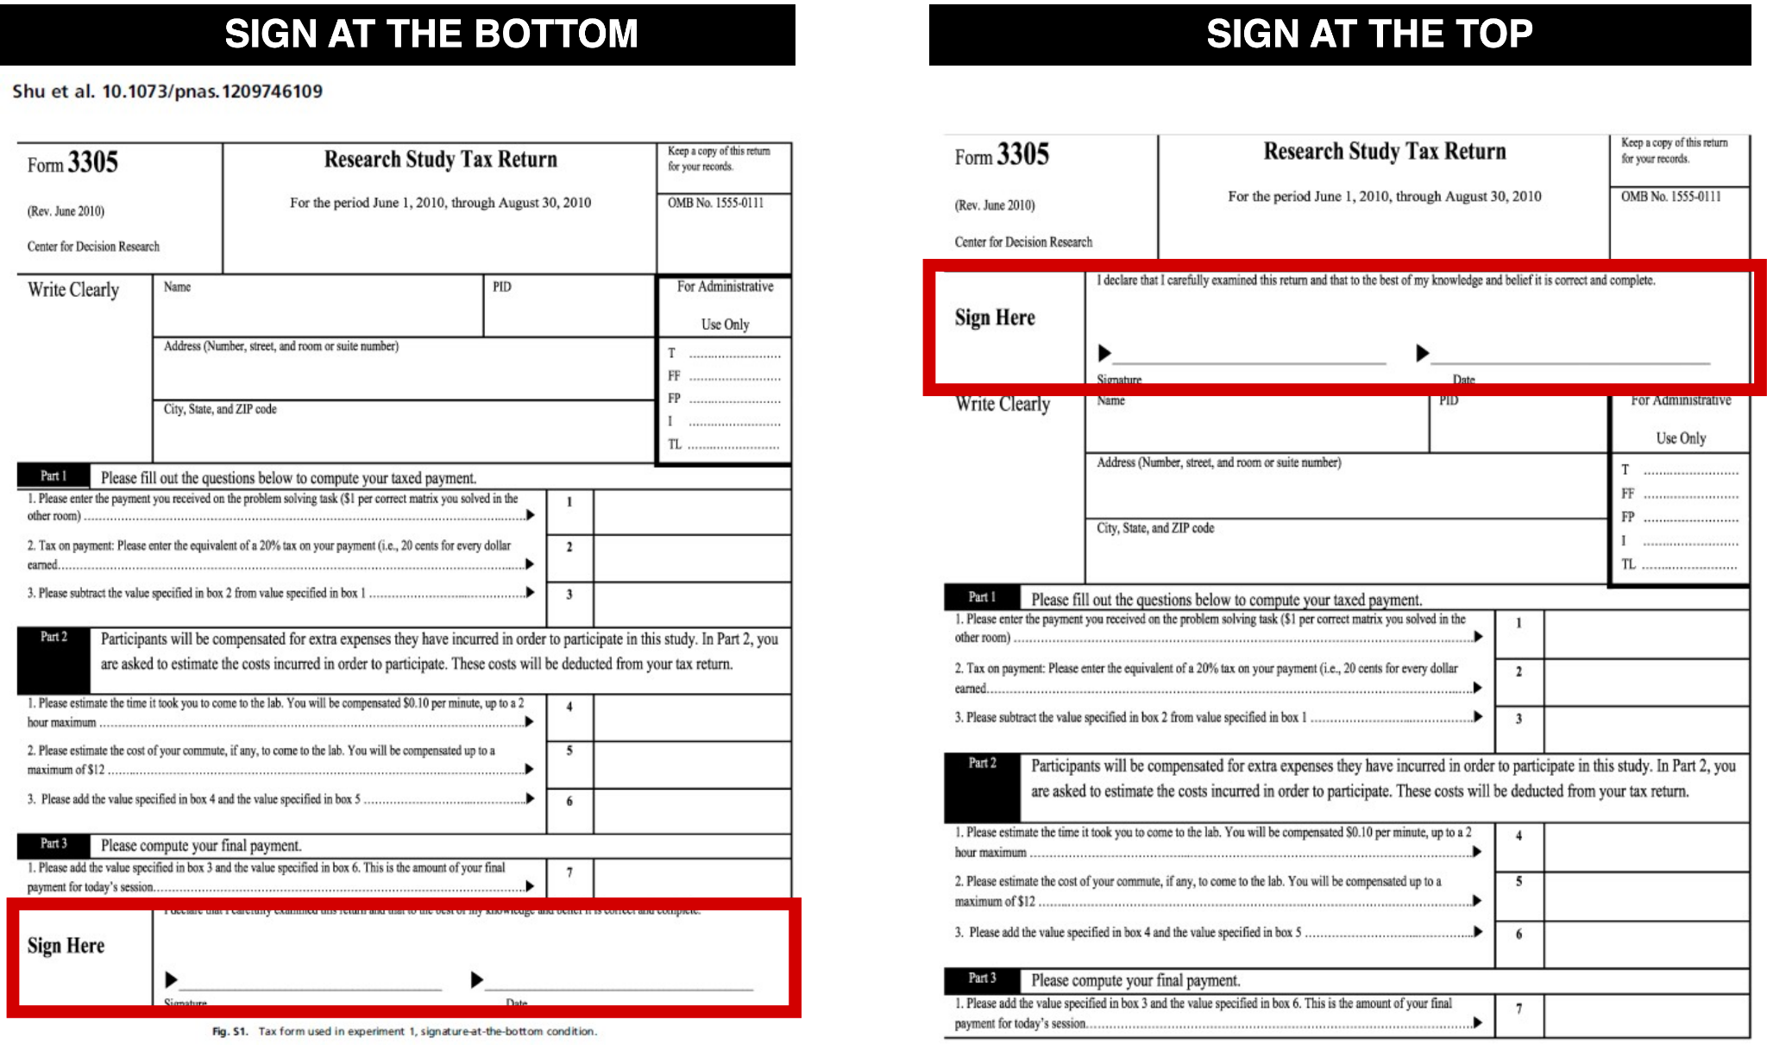
Introducing: Nudge Theory
Claim: Honesty pledges at the top of a form impacts how truthful people are

Slide 21




Duke’s Dan Ariely and Harvard’s Francesca Gino used selective reporting and falsified data to inflate the statistical significance of their published findings

Slide 22
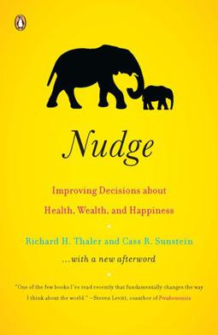
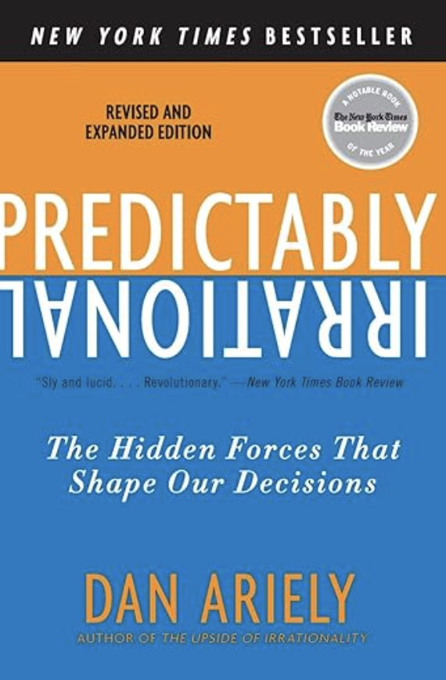


Abusing hypothesis testing may have created a multi-billion dollar industry: books, social experiments, and influenced CPG companies

Slide 23
M S D S 6 1 0 | F A L L 2 0 2 3 | F I N A L P P T
Hypothesis Testing
S A N G J U N | S H R E Y | B E L I N D A

Slide 24
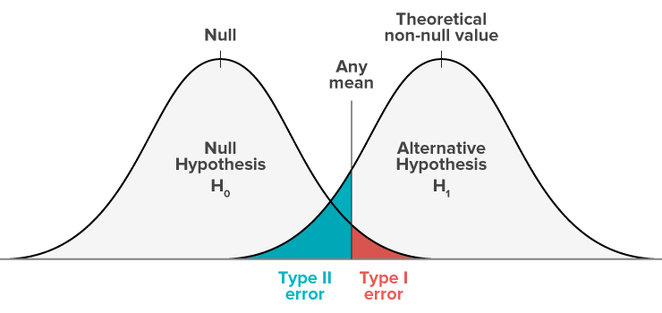

Slide 25

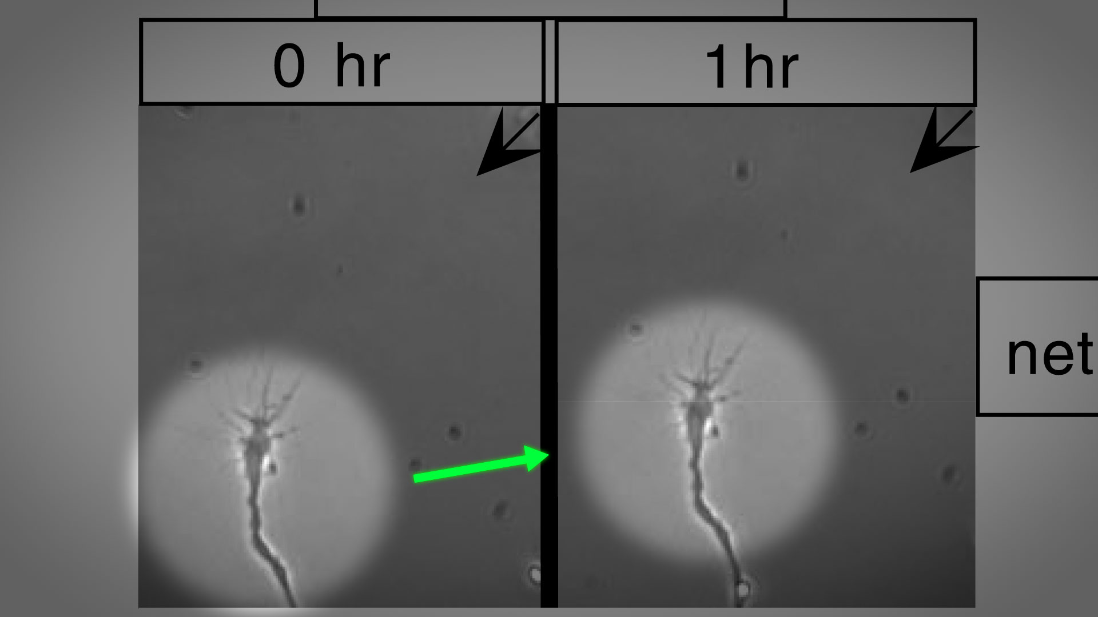

Stanford’s Marc Tessier-Lavigne falsified data to support the claim that certain molecules promoted nerve regeneration
Notes:
https://boardoftrustees.stanford.edu/wp-content/uploads/sites/5/2023/07/Scientific-Panel-Final-Report.pdf

